Slide 1
Summer research project 2020
Jiawei Li (Michael)
School of Computer Science, UNNC

Slide 2
How to do scientific research?
Science == knowledge.
Scientific research: to create scientific knowledge.

Slide 3
How to do scientific research?
Step 1: Choose a topic;
Step 2: Literature review;
Step 3: Choose your research method(s);
Step 4: Do experiments;
Step 5: Check the results;
Step 6: Write a paper, or go to step 3;

Slide 4
Artificial Intelligence
What is intelligence?
The capability for logic, understanding, learning, reasoning, planning, critical thinking, problem solving…
Artificial intelligence:
To create intelligence through the study and design of ‘intelligent agents’ or ‘rational agents’.

Slide 5
Intelligent Agent
Agent: refers to an autonomous entity which makes decisions to achieve goals.
Features of agents:
  Abstract
  Autonomous
  ?

Slide 6
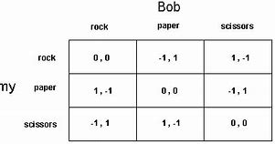
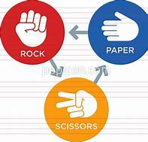
Game theory
Paper-scissors-stone game

Slide 7
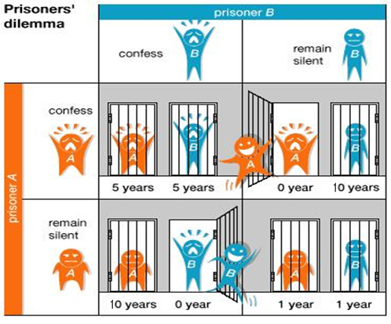
Iterated Prisoner’s Dilemma (IPD)
Prisoner’s dilemma: Two suspects are arrested by the police…

Slide 8
Utility theory
Utility: Within economics, the concept of utility is used to model worth or value. Its usage has evolved significantly over time. The term was introduced initially as a measure of pleasure or satisfaction within the theory of utilitarianism by moral philosophers such as Jeremy Bentham and John Stuart Mill. The term has been adapted and reapplied within neoclassical economics, which dominates modern economic theory, as a utility function that represents a consumer's preference ordering over a choice set. Utility has thus become a more abstract concept, that is not necessarily solely based on the satisfaction/pleasure received.

Slide 9
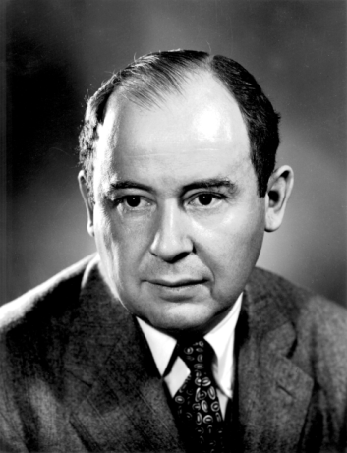
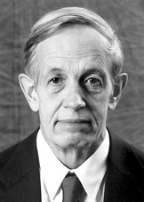
So far game theory has three branches:
Non-cooperative game theory
  In a non-cooperative game, the players make their choices independently in order to maximize their own payoffs.
Cooperative game theory
  In a cooperative game, the players try to form coalitions. Within a coalition, the players make choices collectively to maximize the payoff of the coalition.
John von Neumann
John Nash

Slide 10
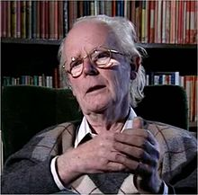
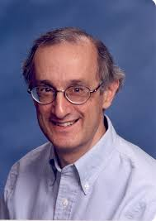
Evolutionary game theory
Evolutionary game theory (EGT) is the application of game theory to evolving population of lifeforms. [Wikipedia]
EGT originated in 1973 when a paper by John Maynard Smith and George R. Price published on Nature.
EGT thrived after Axelrod’s Iterated Prisoner’s Dilemma (IPD) competitions in 1982 and book ‘The evolution of cooperation’.
John Maynard Smith
Robert Axelrod

Slide 11
Assumptions in Game Theory
In non-cooperative games, the players are rational and they only care for their own payoffs.
In cooperative games, the players are completely cooperative within a coalition and they care for the payoffs of other players as equally as their own payoffs.

Slide 12
Why EGT?
EGT integrates game models and evolving population.
EGT discards some axiomatic assumptions that classical game theory is based on, such as rationality.
What if a player does not adopt equilibrium strategy?
EGT does not require the assumption of rationality, it only requires that every player has a strategy.

Slide 13
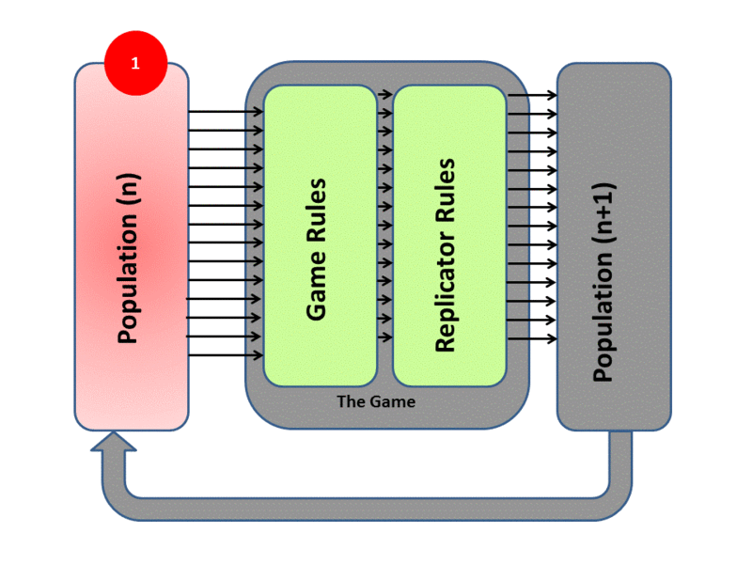
Model of EGT
The model deals with a Population.
The individuals play game against each other.
Based on this resulting fitness each member of the population then undergoes replication or culling determined by the exact mathematics of the Replicator Dynamics Process.
The new generation then takes the place of the previous one and the cycle begins again

Slide 14
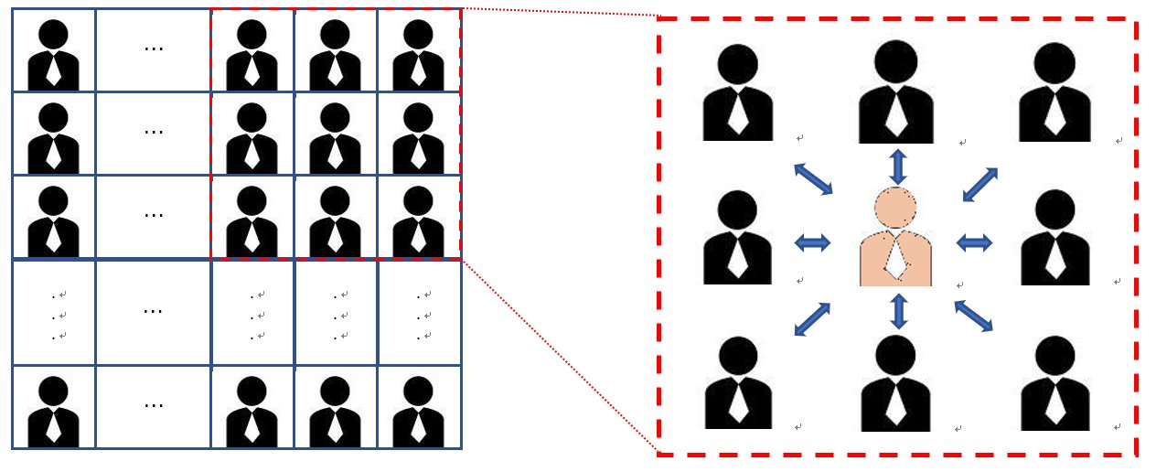
Simulation using agents
A spatial IPD. There are n×n agents located on a n×n grid. Each agent has a strategy and only plays IPD with its direct neighbours. After interactions between neighbours, each site is occupied by the agent who receives the highest payoff in the neighbourhood.

Slide 15
Simulation of economic and social behaviours in a population by using agents
Evolution of cooperation in human societies
Collective behaviour in immigrants
Economic decision making in a market
  Bargaining
  Discriminative price
  Coalition/collective behaviour

Slide 16
Team 1: Simulating immigrants movement by using a spatial IPD with move option
Team leader: Bingchen Lin
Methods: spatial IPD with move option
Objective: to investigate collective behaviour in immigrants movement

Slide 17
Team 2: Simulating bargaining in a market using agents
Team leader: Shuning Pan
Methods: spatial model of agents, bargaining
Objective: to investigate bargaining in a spatial grid of agents

Slide 18
Team 3: Simulating competition-cooperation choice in a market using agents
Team leader: Yi Xue
Methods: spatial model of agents, iterated howk-dove game
Objective: to investigate competition-cooperation choice in an evolutionary process

Slide 19
Team 4: Simulating social hierarchy by using evolutionary game theory
Team leader: ?
Methods: spatial prisoner’s dilemma, collective strategy, replicator dynamics
Objective: to investigate which social structure is better, autocratic or democratic, in a specific environment.

